Slide 1
AI-Powered Nutrition Guidance:
A Machine Learning
Approach to Food Recommendations
and Calorie Prediction

Slide 2
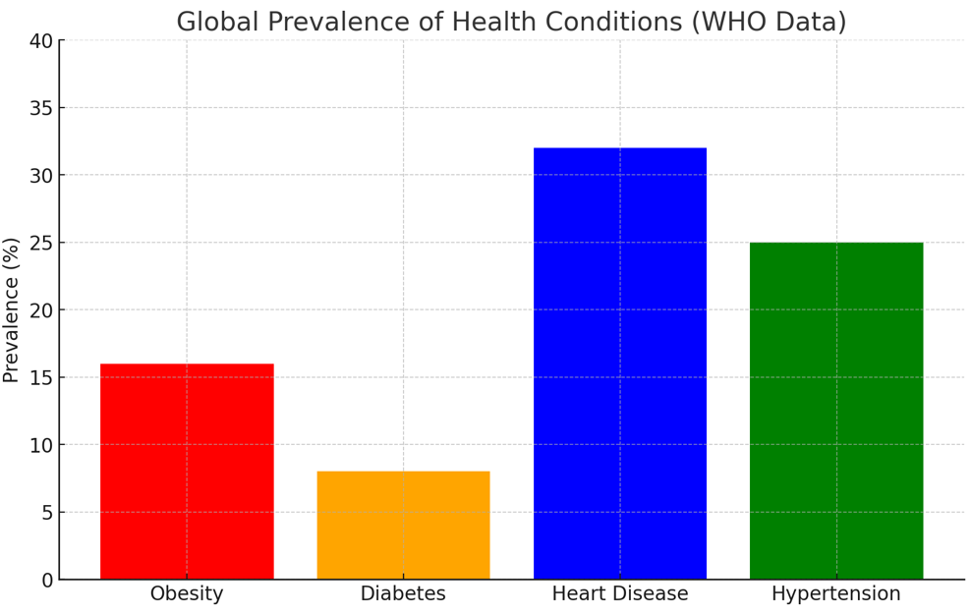
Introduction and Motivation
Modern diets, dominated by processed foods, contribute to rising health issues like obesity, diabetes, and heart disease. According to the World Health Organization (WHO), 63% of global deaths are linked to poor dietary habits. Many individuals struggle with nutritional awareness and meal planning, while existing systems fail to provide personalized dietary recommendations suited to individual health goals.
AI-powered nutrition guidance addresses this by analyzing food composition, predicting calorie content, and offering personalized meal recommendations using machine learning. This data-driven approach simplifies decision-making, promotes healthier eating habits, and supports better long-term health outcomes.

Slide 3
Project Objectives
Main Goal: Build an AI-driven system for calorie prediction and food recommendations based on user input.
Specific Objectives:
🎯 Accurately Predict Calories – Develop a calorie prediction model using machine learning.
✅ Enhance Dietary Choices – Help users make healthier food choices through recommendations.
📊 Utilize Data Mining – Extract insights from food nutrition datasets.
👩‍💻 Improve User Experience – Provide an intuitive and interactive recommendation system.

Slide 4
Dataset Overview
📌 Dataset Name: The Nutritional Content of Food (ABBREV.csv)
📍 Source: Kaggle-U.S. Department of Agriculture (USDA)
Key Features:
📊 Total Records: ~5,000 food items
📌 Attributes: 20+ features (e.g., food name, calories, protein, fats, carbs, etc.)
🍎 Nutritional Focus: Macronutrients & micronutrients
Why This Dataset?
Comprehensive nutritional information 🥦
Reliable source 📜
Suitable for calorie prediction & food recommendations

Slide 5
Methodology
Data Mining Pipeline & Methodology.
Dataset Preprocessing
Handling missing values (median imputation) & duplicate removal.
Outlier detection using Z-Score.
Feature selection for key attributes: Calories, Protein, Lipids, Carbs, Fiber, Sugar.
Scaling: Min-Max Normalization & Standardization (StandardScaler).
Data Mining Techniques
Calorie Prediction: Random Forest, Linear Regression, K-Nearest Neighbors (KNN), and Gradient Boosting.
Food Recommendation: K-Means Clustering & Cosine Similarity.
Dimensionality Reduction: PCA for clustering efficiency.
Evaluation Metrics
Regression Models: MSE, MAE, R² Score.
Clustering: Silhouette Score (0.55), Davies-Bouldin Index (0.63), WCSS (8321.44).

Slide 6
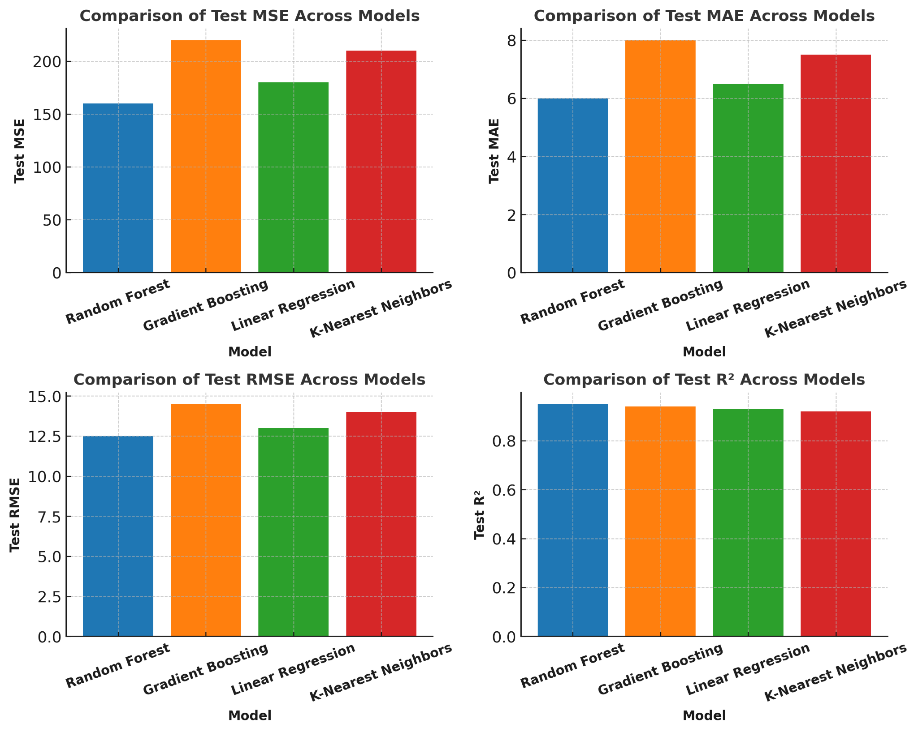
Calorie Prediction Model
Model Selection
Random Forest Regressor (Best Model)
Baseline models: Linear Regression, K-Nearest Neighbors (KNN), Gradient Boosting.
Models performance evaluations:

Slide 7
Calorie Prediction Model
Random Forest Performance
Mean Squared Error (MSE) = 171.2998
Mean Absolute Error (MAE) = 5.8075
R² Score = 0.9939 (high accuracy)
Comparison with Other Models
Linear Regression & KNN had higher errors and lower accuracy.
Gradient Boosting was competitive but more computationally expensive.

Slide 8
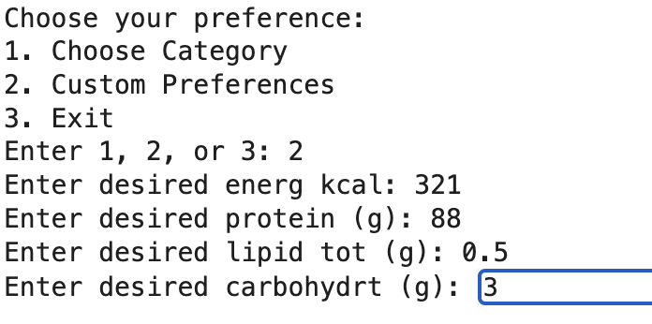
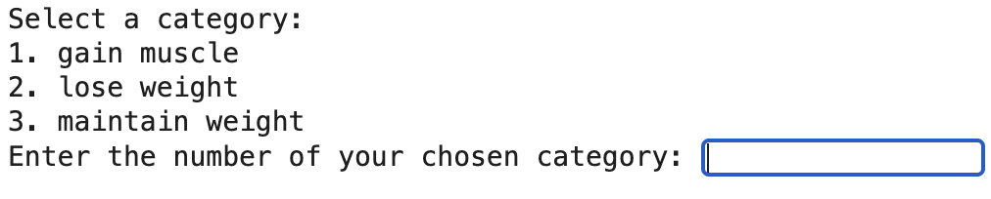
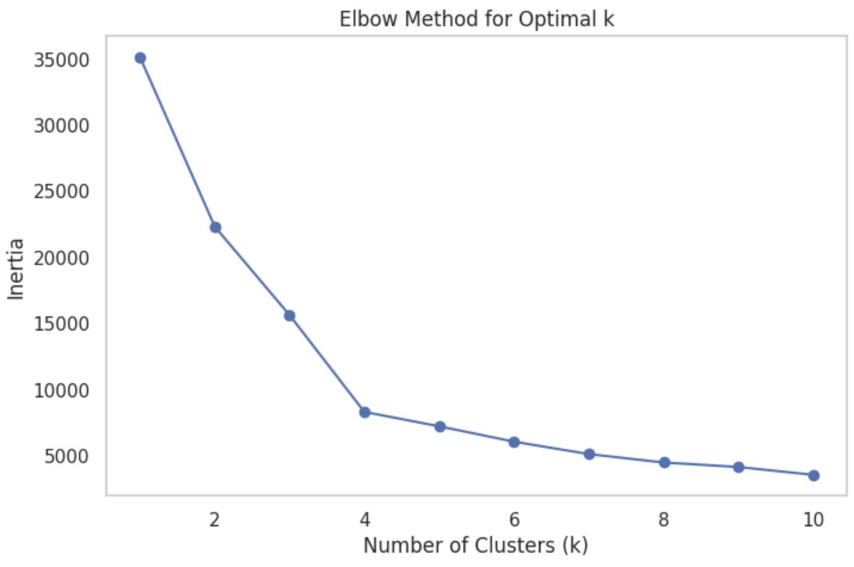
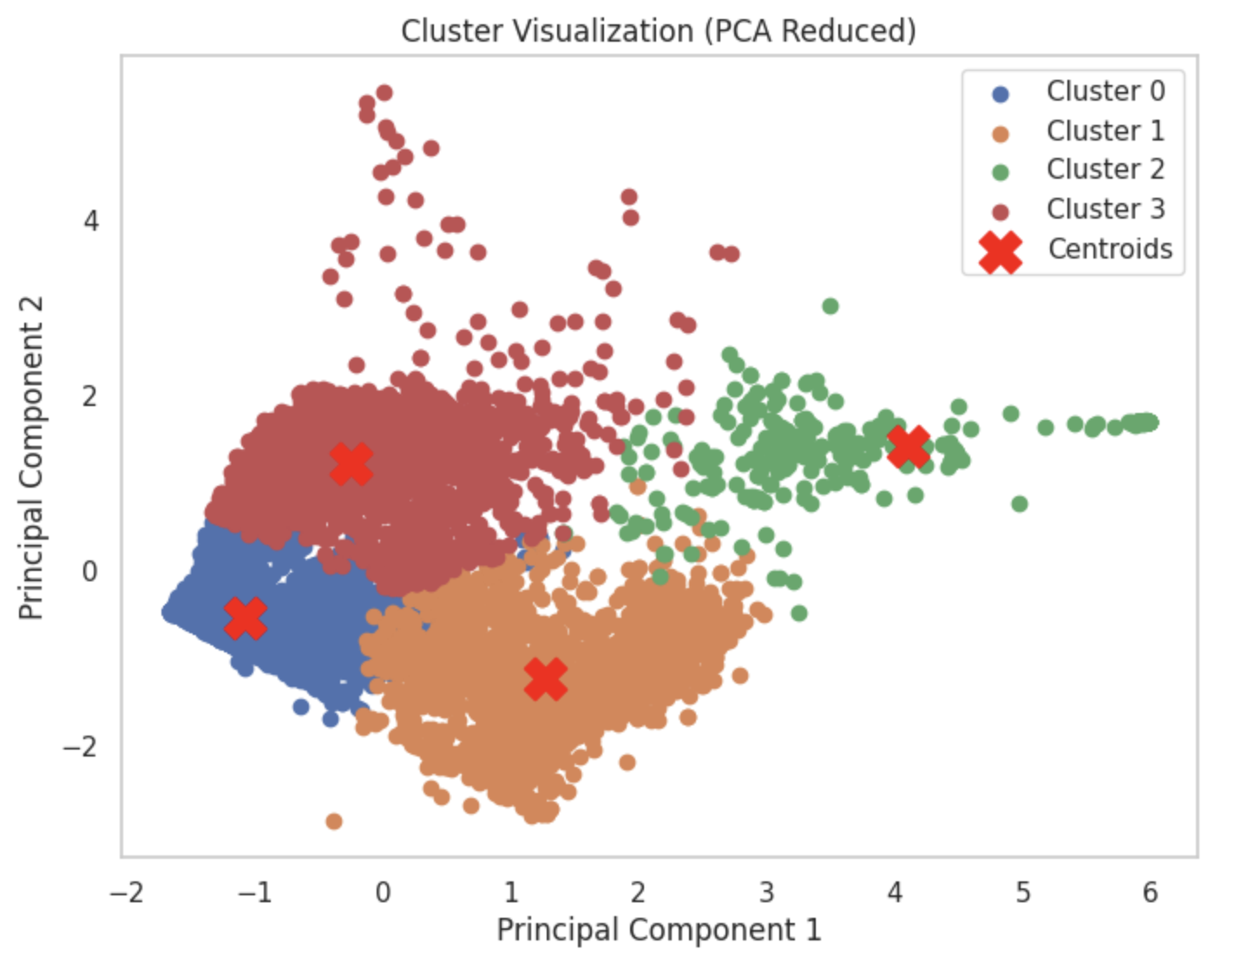



Food Recommendation Using K-Means Clustering
-Two Methods of user input:
[1] Enter Custom Preferences
[2] Choose Category
INITIAL TARGET: Aim to cluster foods using K-Means based on the user input & rank the items using cosine similarity.
Feature Selection: Energy(Kcal), Protein(g), Lipid_Fats(g),Carbohydrate(g)
Workflow:
1-Optimal Clusters
2-Clustering & Visualisation
3-Function() to get user input & Predict Cluster
4-Function() to calculate similarity, get metrics & Recommend Foods
Food Recommendation:
-Calculate cosine similarity scores and rank top 20 food items
Sample output:
Elbow Method to determine Optimal No of Clusters
Metrics used:
Silhouette Score: Cluster separation and cohesion are measured by using this feature.
Davies Bouldin Index: Measures compactness and separation of clusters.
Inertia: Measures tightness,internal variance.
Cluster Visualisation
Results:
Silhouette Score suggests moderately well defined clusters.
Davies Bouldin Index suggests good cluster separation.
Inertia indicates clusters are fairly compact but still have some internal variance.
In the future I would like integrating this recommendation via streamlit to provide real-time recommendations and enhance user experience.

Slide 9
Conclusion
Key Achievements
Successfully predicted calorie values with Random Forest (MSE: 171.3, R²: 0.9939).
Clustered food items using K-Means for personalized recommendations.
Used Cosine Similarity for tailored meal suggestions based on nutritional goals.
Impact & Insights
Lipids & Carbohydrates are primary calorie contributors.
Protein-rich foods identified through macronutrient analysis.
Clustering effectively groups foods by nutritional profiles.

Slide 10
Thank You!

